Slide 1
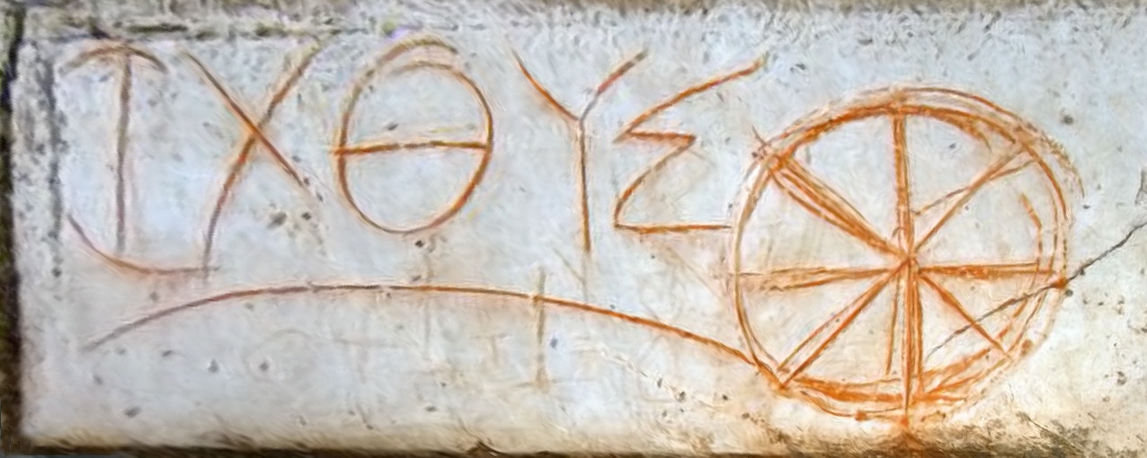
· Title: “Early Christian inscription with [ichthus]”
· Origin: Ephesus
· Date: 2nd century

Slide 2
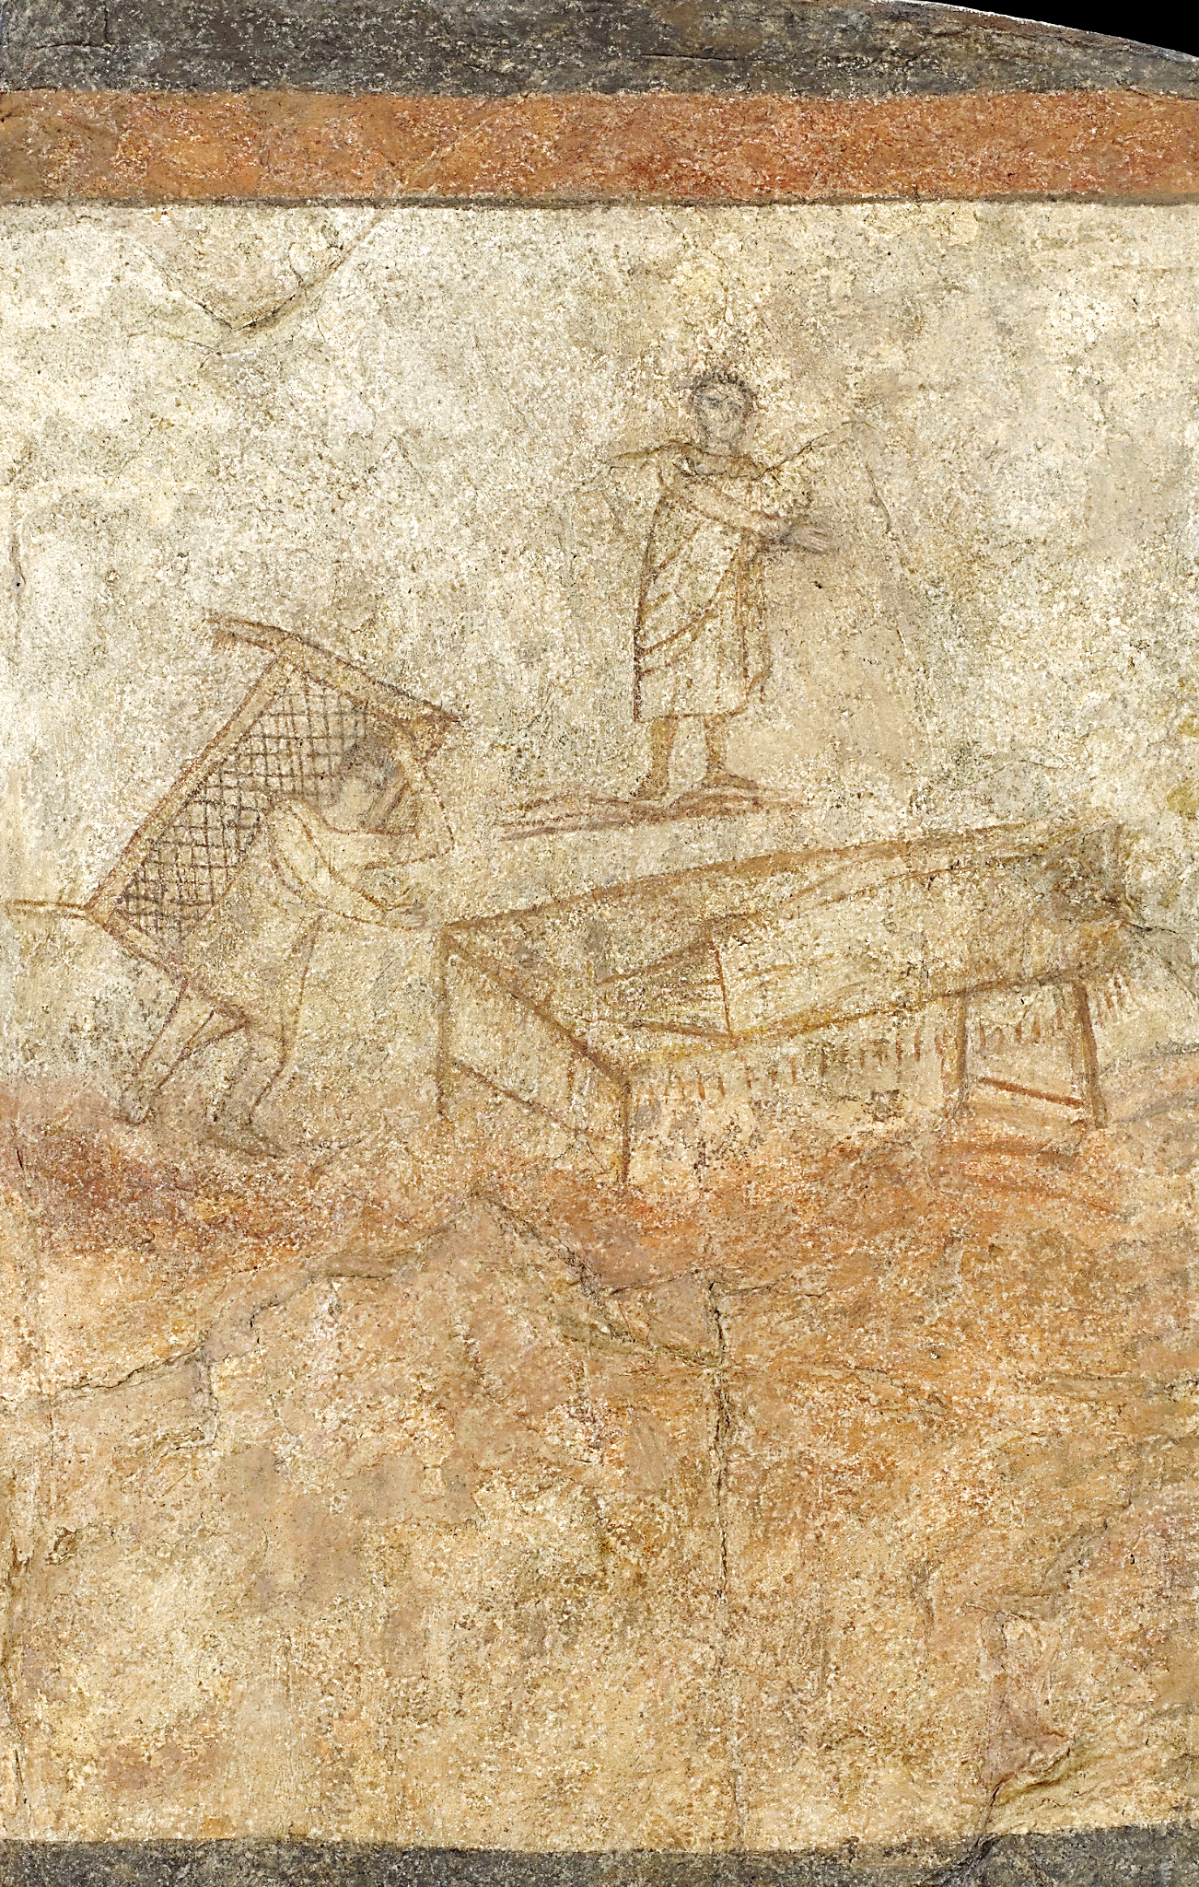
· Title: “Christ Healing the Paralytic”
· Origin: Dura Europos, Syria
· Date: c. 232

Slide 3
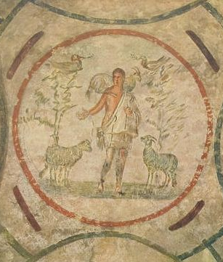
· Title: “The Good Shepherd”
· Origin: Rome
· Date: mid to late 3rd century

Slide 4
· Title: “Jesus Christ Flanked by Saint Peter and Saint Paul”
· Origin: Rome
· Date: 4th century

Slide 5
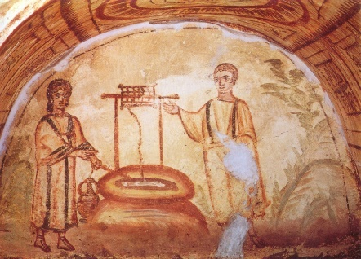
· Title: “Jesus with the Samaritan Woman at the Well of Jacob”
· Origin: Rome
· Date: 4th century

Slide 6
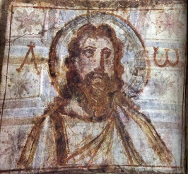
· Title: “Image of Christ”
· Origin: Rome
· Date: late 4th century

Slide 7
· Title: “The Icon of Christ of Latamos”
· Origin: Greece
· Date: 5th century

Slide 8
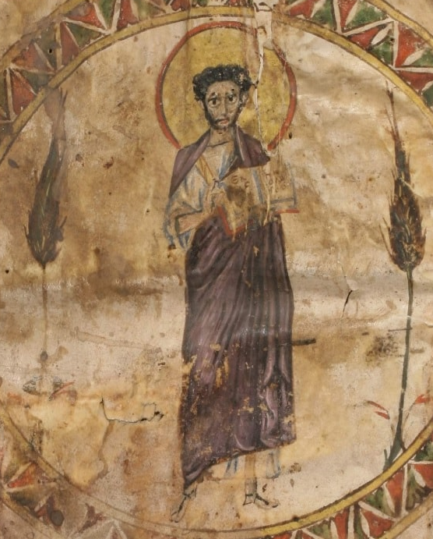
· Title: “Syriac Miniature of Christ”
· Origin: Turkey
· Date: 6th century

Slide 9
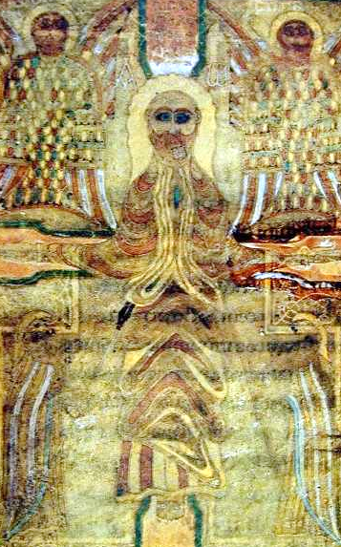
· Title: “The Crucifixion”
· Origin: England
· Date: 7th century

Slide 10
· Title: “Christ in Majesty”
· Artist: Godescalc
· Origin: Carolingian
· Date: between c. 781 and c. 783

Slide 11
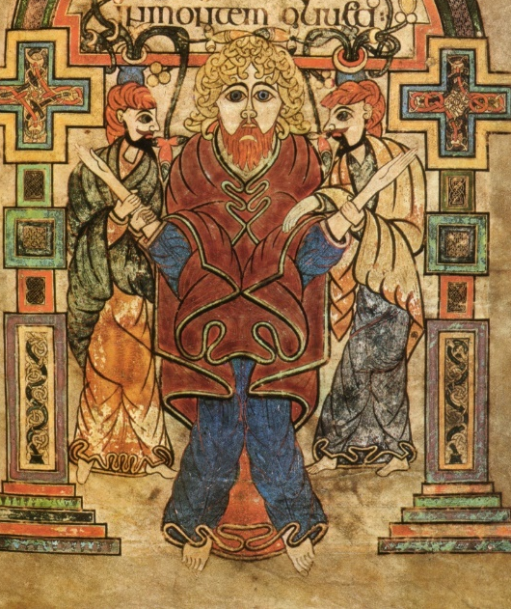
· Title: “Arrest of Christ”
· Artist: Unknown
· Origin: Ireland
· Date: 9th century

Slide 12
· Title: “Psalter of Ludwig the German”
· Artist: Unknown
· Origin: Germany
· Date: 9th century

Slide 13
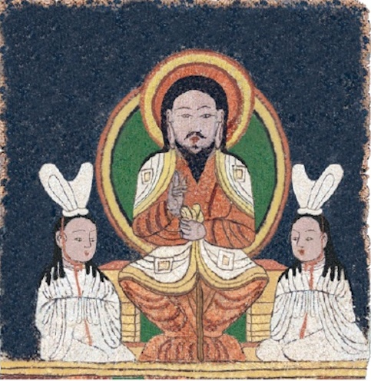
· Title: “Reconstruction of the Enthroned Jesus Image on a Manichaean Temple Banner”
· Artist: Unknown
· Origin: China
· Date: c. 10th century

Slide 14
· Title: “The Lord in the Clouds”
· Artist: Urgell Beatus
· Origin: Spain
· Date: c. 975

Slide 15
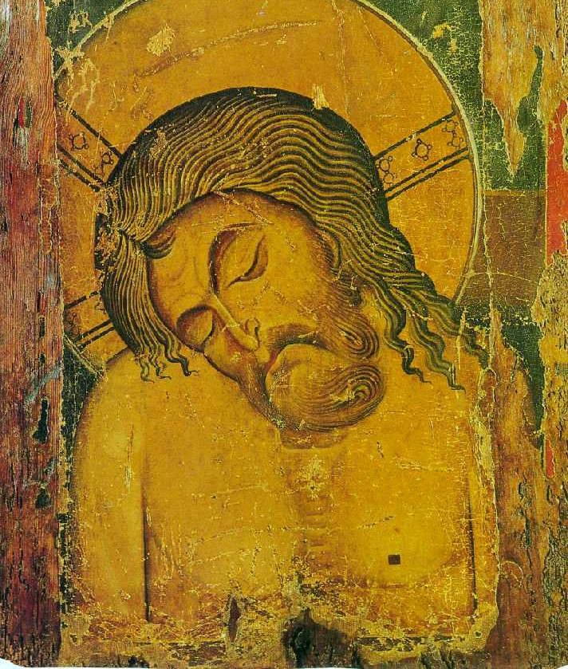
· Title: “Dead Christ”
· Artist: Unknown
· Origin: Greece
· Date: 12th century

Slide 16
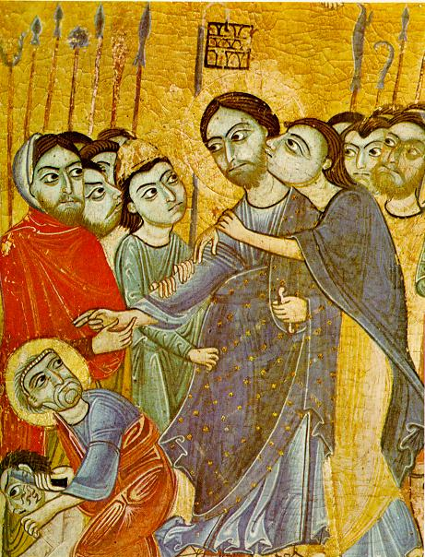
· Title: “Kiss of Judas”
· Artist: Unknown
· Origin: Pisa
· Date: between 1180 and 1200

Slide 17
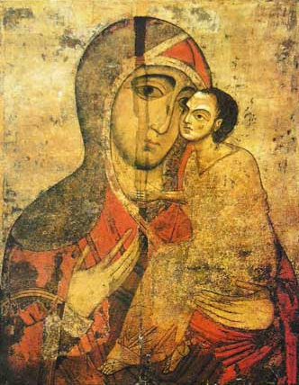
· Title: “Our Lady of Tenderness of Starorusskaya”
· Artist: Unknown
· Origin: Russia
· Date: 13th century

Slide 18
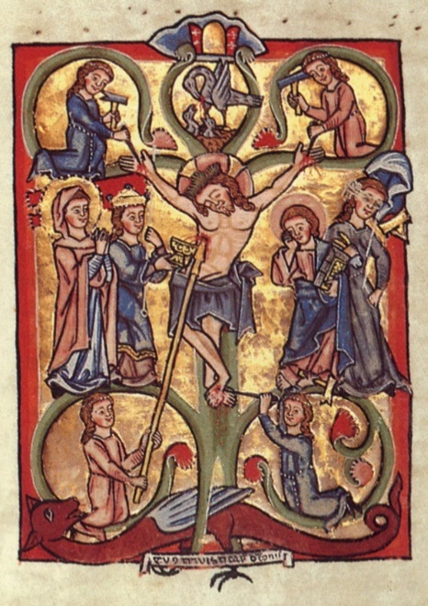
· Title: “Tree of Life”
· Artist: Unknown
· Origin: German
· Date: c. 1260

Slide 19
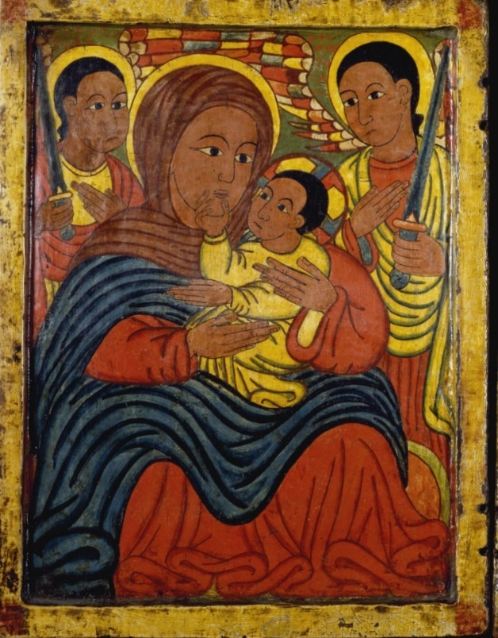
· Title: “Diptych with Mary and Her Son Flanked by Archangels, Apostles, and a Saint”
· Artist: Follower of Fre Seyon
· Origin: Ethiopia
· Date:15th century

Slide 20
· Title: “Ascension”
· Artist: Unknown
· Origin: Armenia
· Date:1434-1435

Slide 21
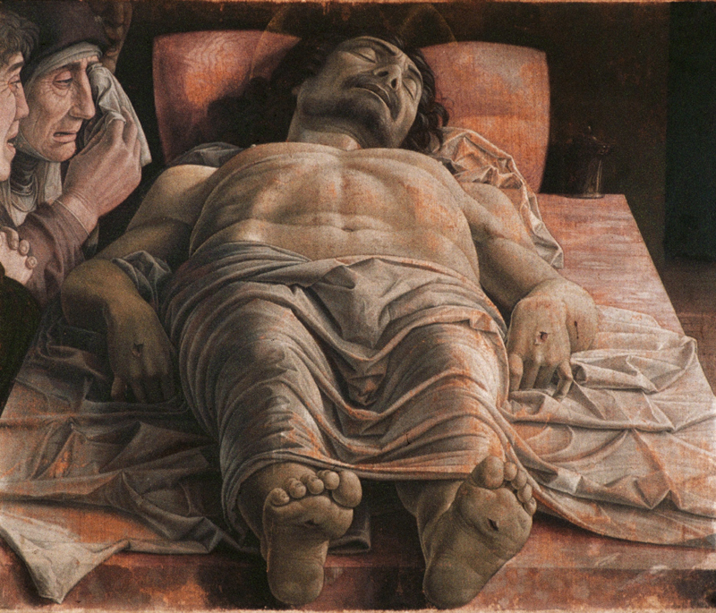
· Title: “Lamentation of Christ”
· Artist: Andrea Mantegna
· Origin: Italy
· Date: c. 1490

Slide 22
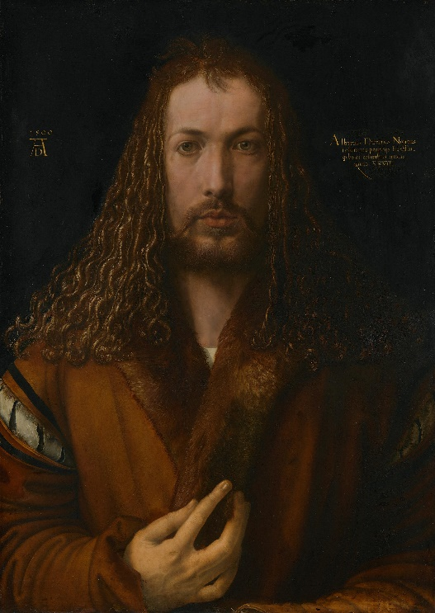
· Title: “Self-Portrait”
· Artist: Albrecht Dürer
· Origin: Germany
· Date: 1500

Slide 23
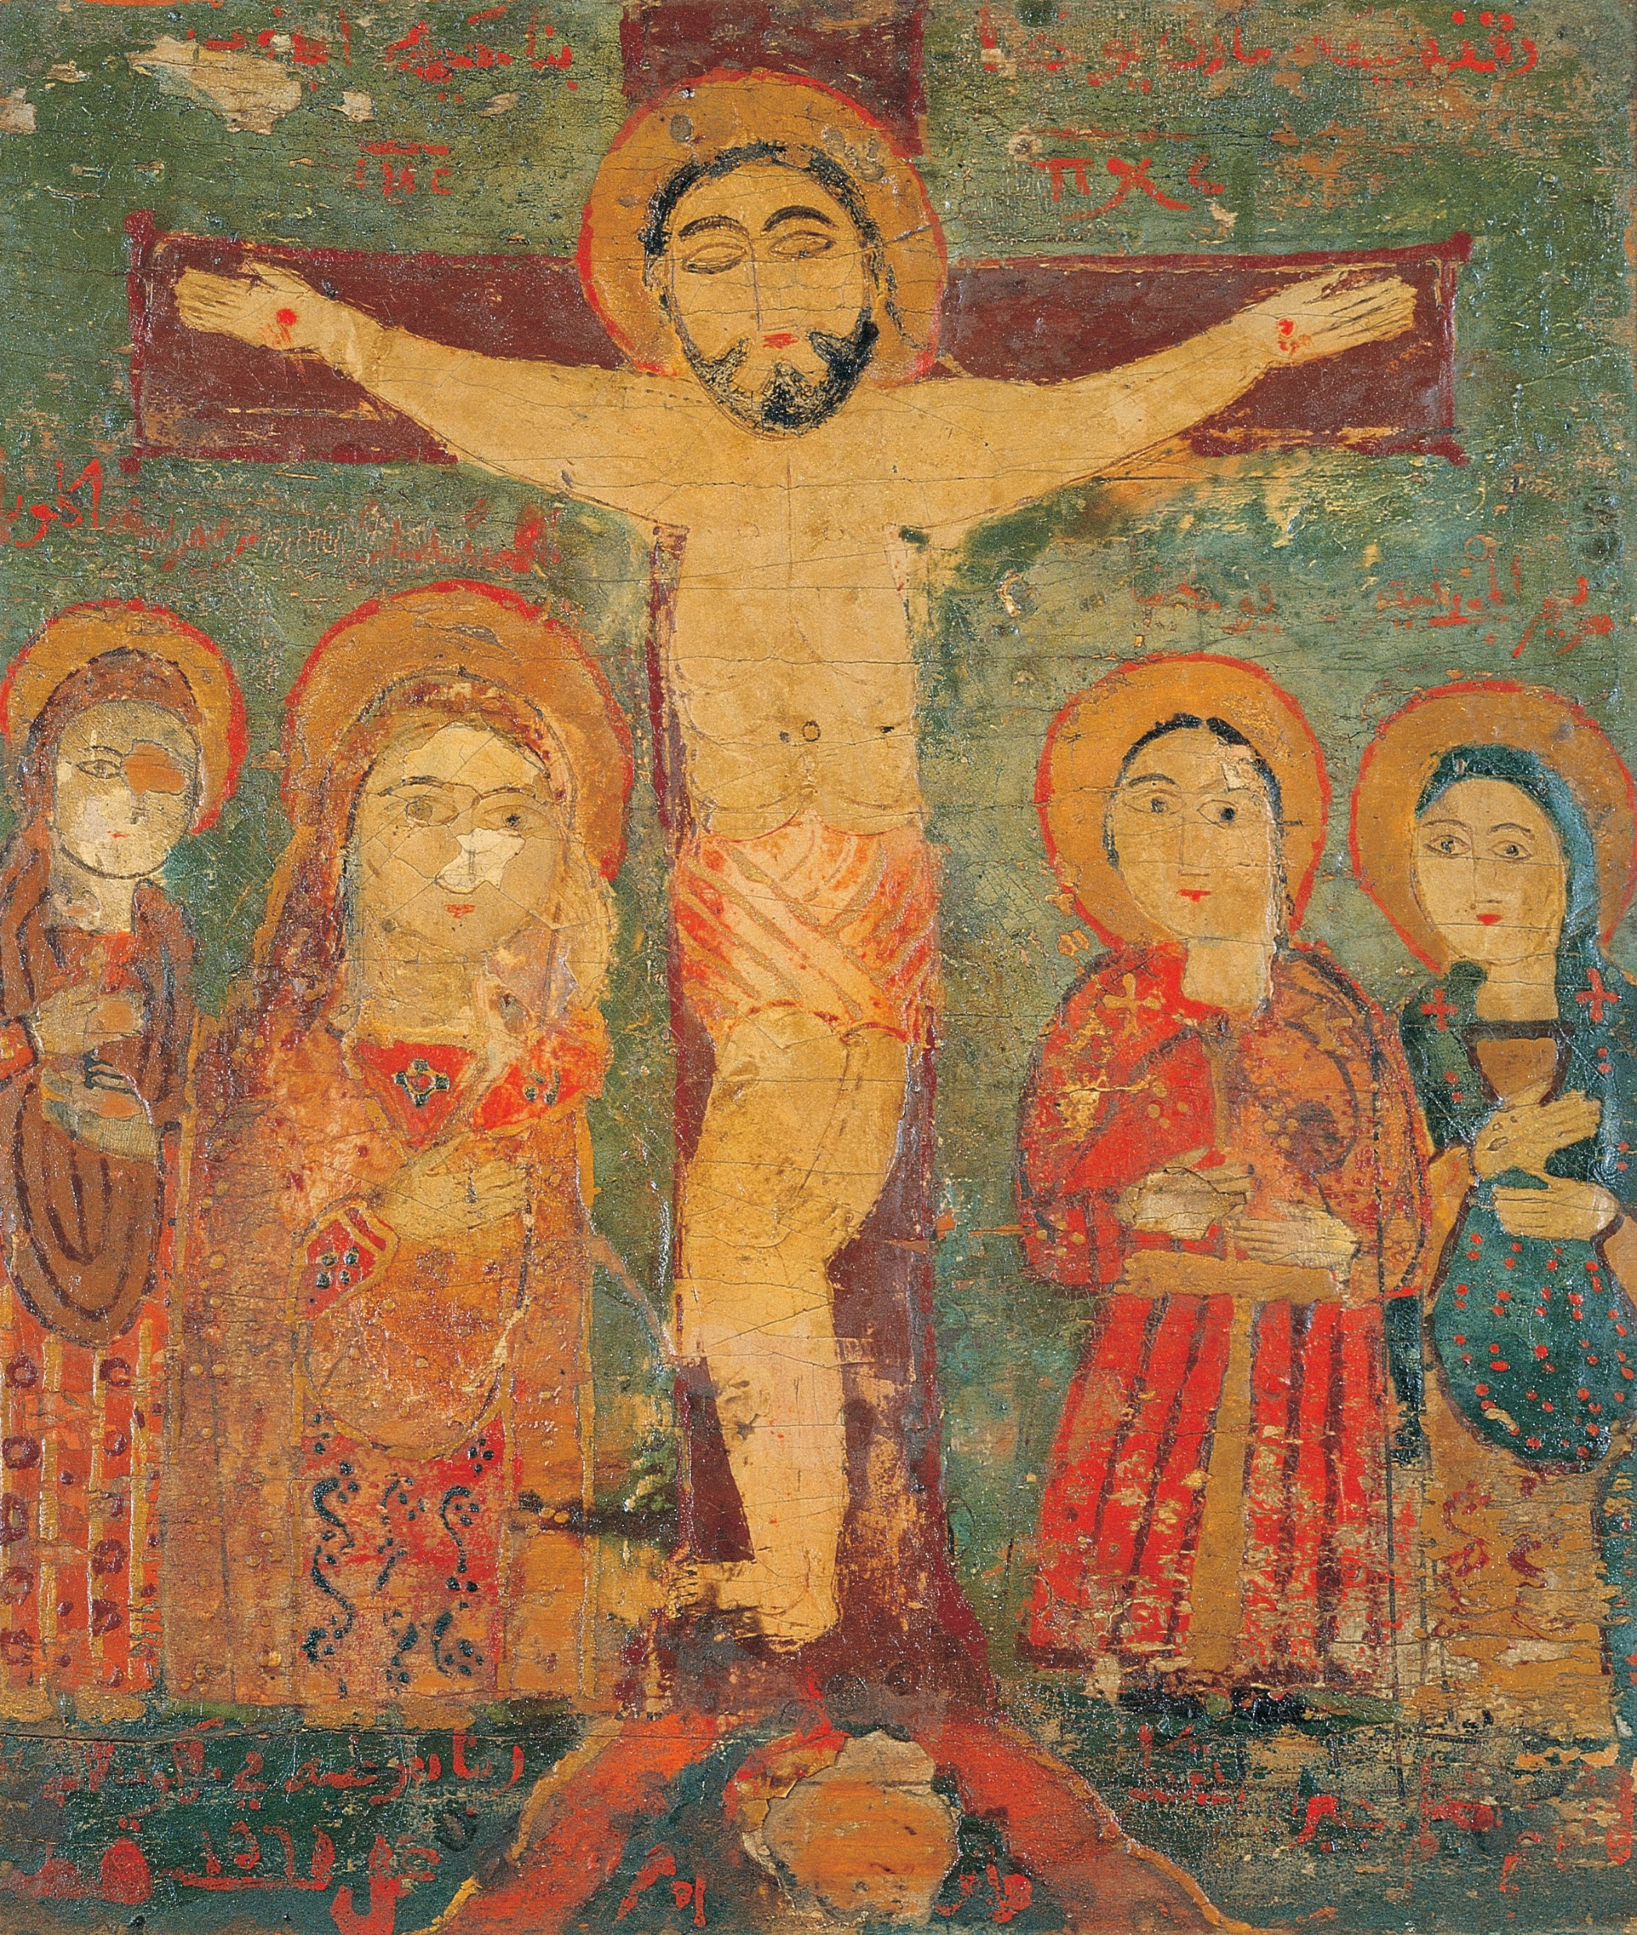
· Title: “The Crucifixion”
· Artist: Unknown
· Origin: Syria or Egypt
· Date: 1560-1569

Slide 24
· Title: “Nativity in the Desert”
· Artist: Sâdeq Mêg
· Origin: Iran
· Date: c. 1595

Slide 25
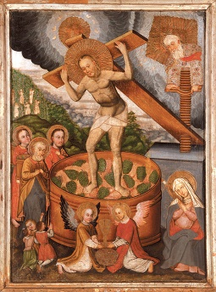
· Title: “Christ in the Grindstone”
· Artist: Unknown
· Origin: Ukraine
· Date: 17th century

Slide 26
· Title: “The Lamentation”
· Artist: Emmanuel Lambardos
· Origin: Crete
· Date: 17th century

Slide 27
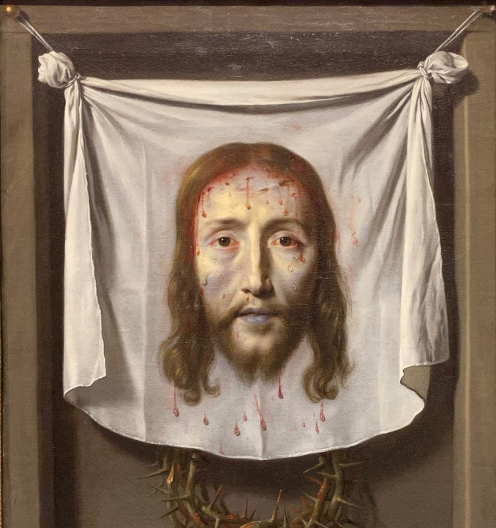
· Title: “The Veil of Saint Veronica”
· Artist: Philippe de Champaigne
· Origin: France
· Date: before 1654

Slide 28
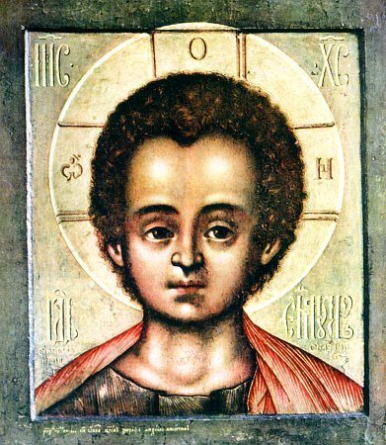
· Title: “Christ Emmanuel”
· Artist: Simon Ushakov
· Origin: Russia
· Date: 1697

Slide 29
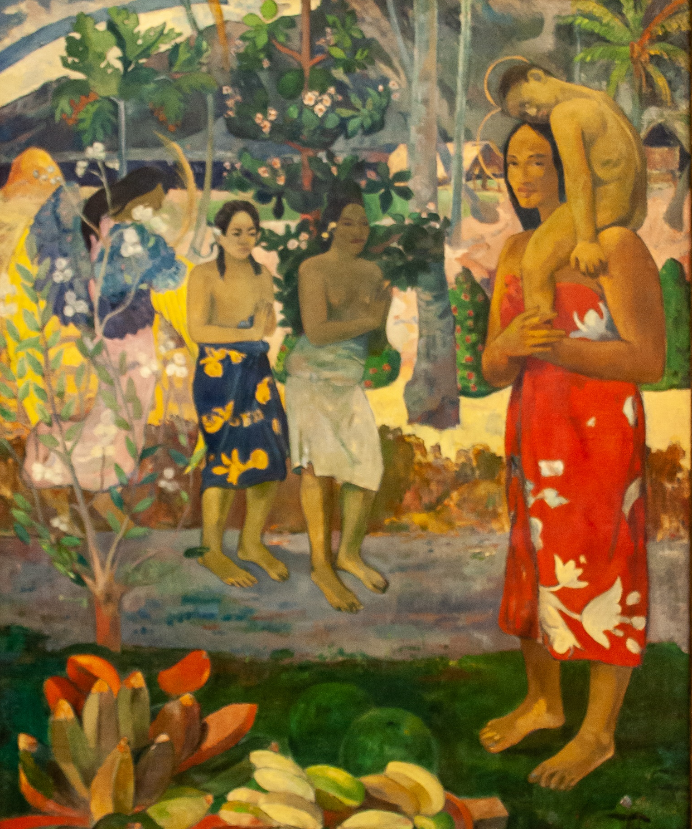
· Title: “Hail Mary”
· Artist: Paul Gauguin
· Origin: France/Tahiti
· Date: 1891

Slide 30
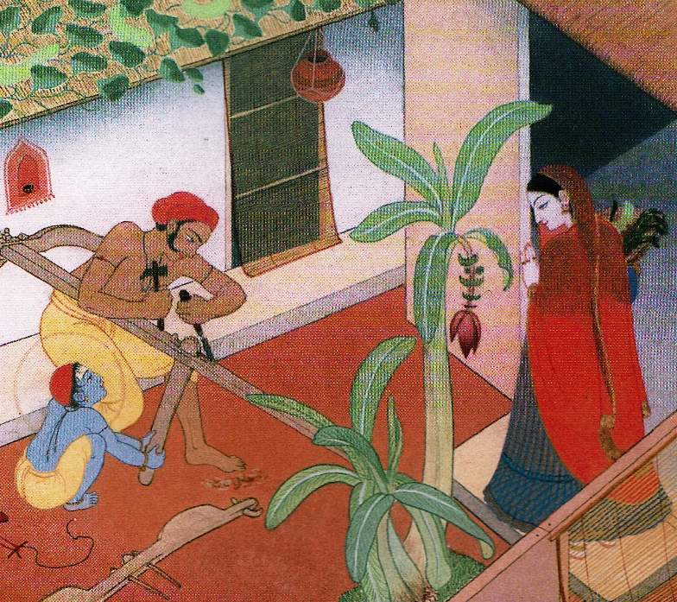
· Title: “Home in Nazareth”
· Artist: Frank Wesley
· Origin: India
· Date: 20th century

Slide 31
· Title: Detail of “Last Supper and Three Wise Men”
· Artist: Unknown
· Origin: Australia
· Date: 20th century

Slide 32
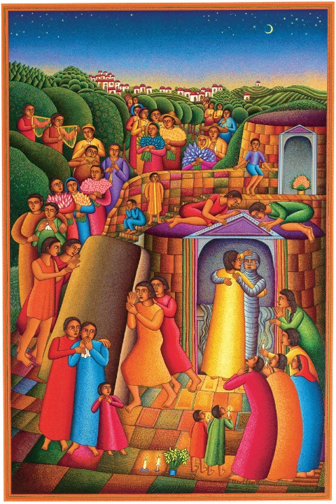
· Title: “Take Away the Stone”
· Artist: John August Swanson
· Origin: America
· Date: 20th century

Slide 33
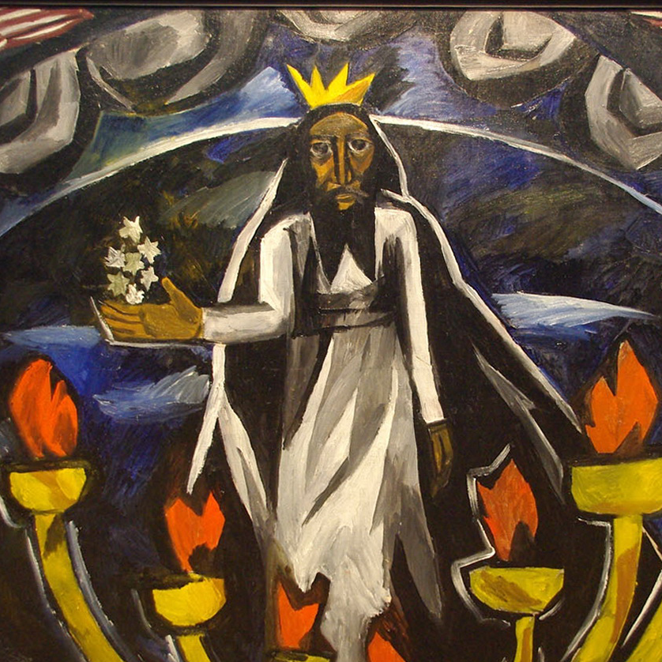
· Title: “Elder with Seven Stars and Candlesticks (Apocalypse)”
· Artist: Natalii︠a︡ Sergeevna Goncharova
· Origin: Russia
· Date: 1910

Slide 34
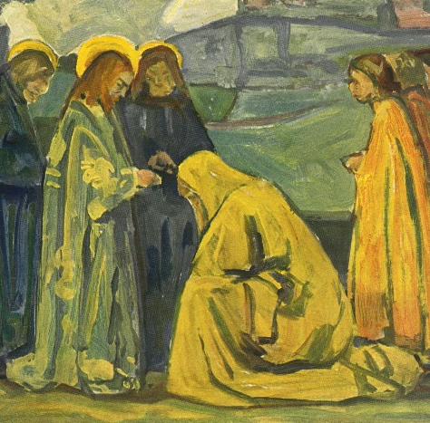
· Title: “Christ and the Canaanite Woman”
· Artist: Adolf Hölzel
· Origin: Germany
· Date: before 1926

Slide 35
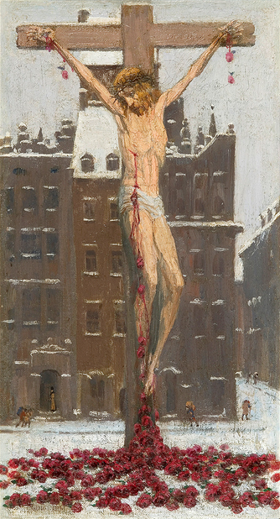
· Title: “Snow Christ”
· Artist: Edward Okuń
· Origin: Poland
· Date: 1929

Slide 36
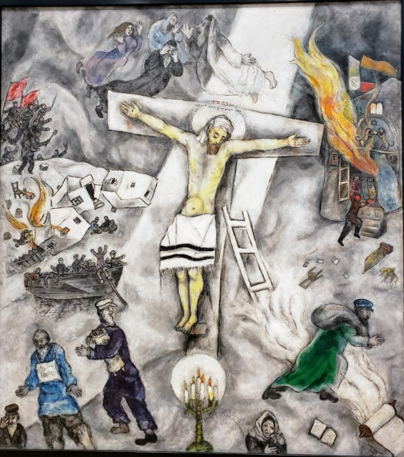
· Title: “White Crucifixion”
· Artist: Marc Chagall
· Origin: Russia
· Date: 1938

Slide 37
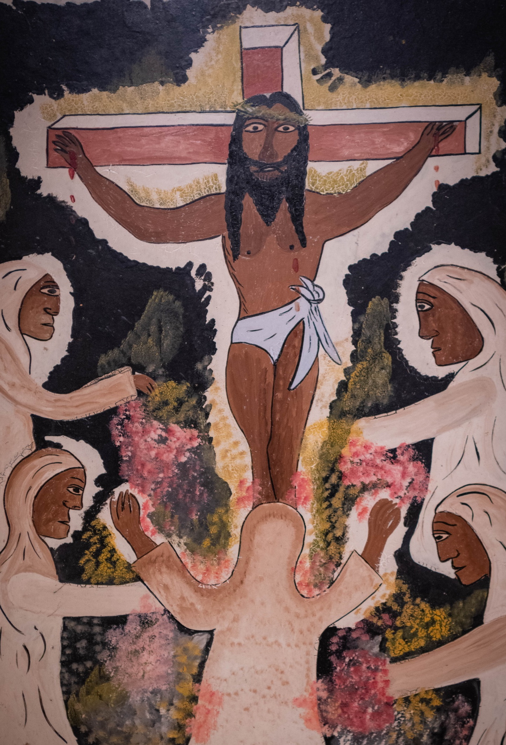
· Title: “The Adoration of Love”
· Artist: Hector Hyppolite
· Origin: Haiti
· Date: c. 1946

Slide 38
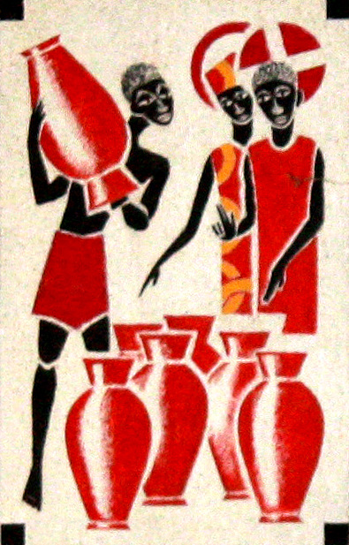
· Title: “Altar of Moussa Abbey”
· Artist: Father George Saget
· Origin: Senegal
· Date: 1963

Slide 39
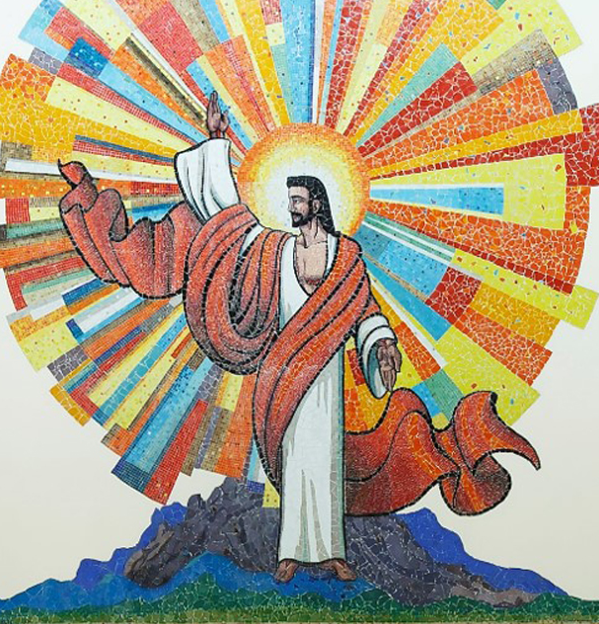
· Title: “Christ Mosaic”
· Artist: Unknown
· Origin: Malaysia
· Date: c. 21st century

Slide 40
· Title: “Jesus with Loaves and Fish”
· Artist: Unknown
· Origin: Kenya
· Date: 21st century (?)

Slide 41
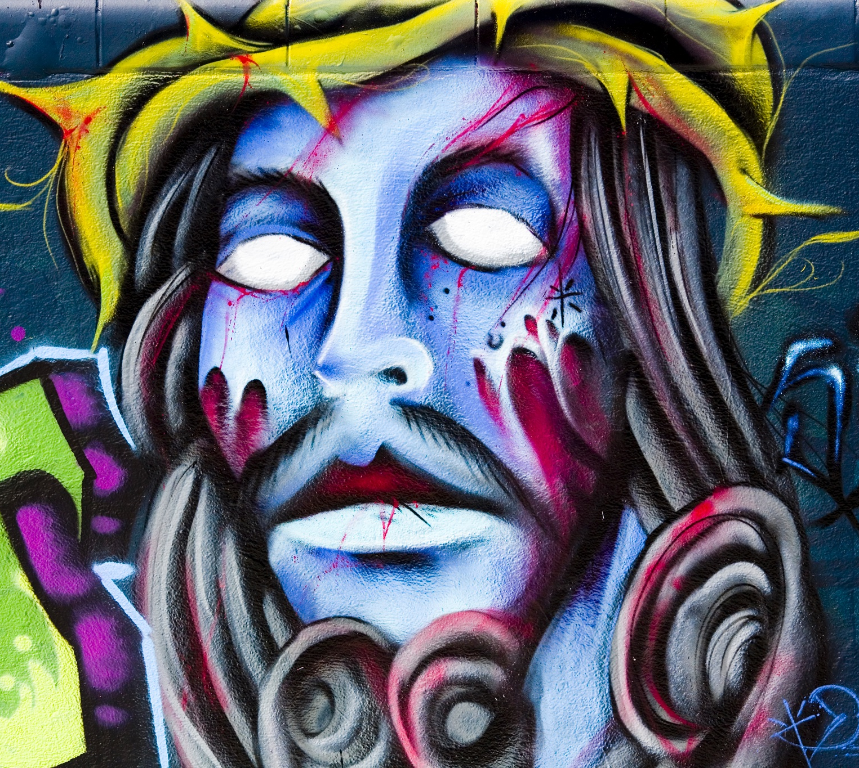
· Title: “Jesus Christ”
· Artist: Photo by Thomas Hawk
· Origin: America
· Date: early 21st century

Slide 42
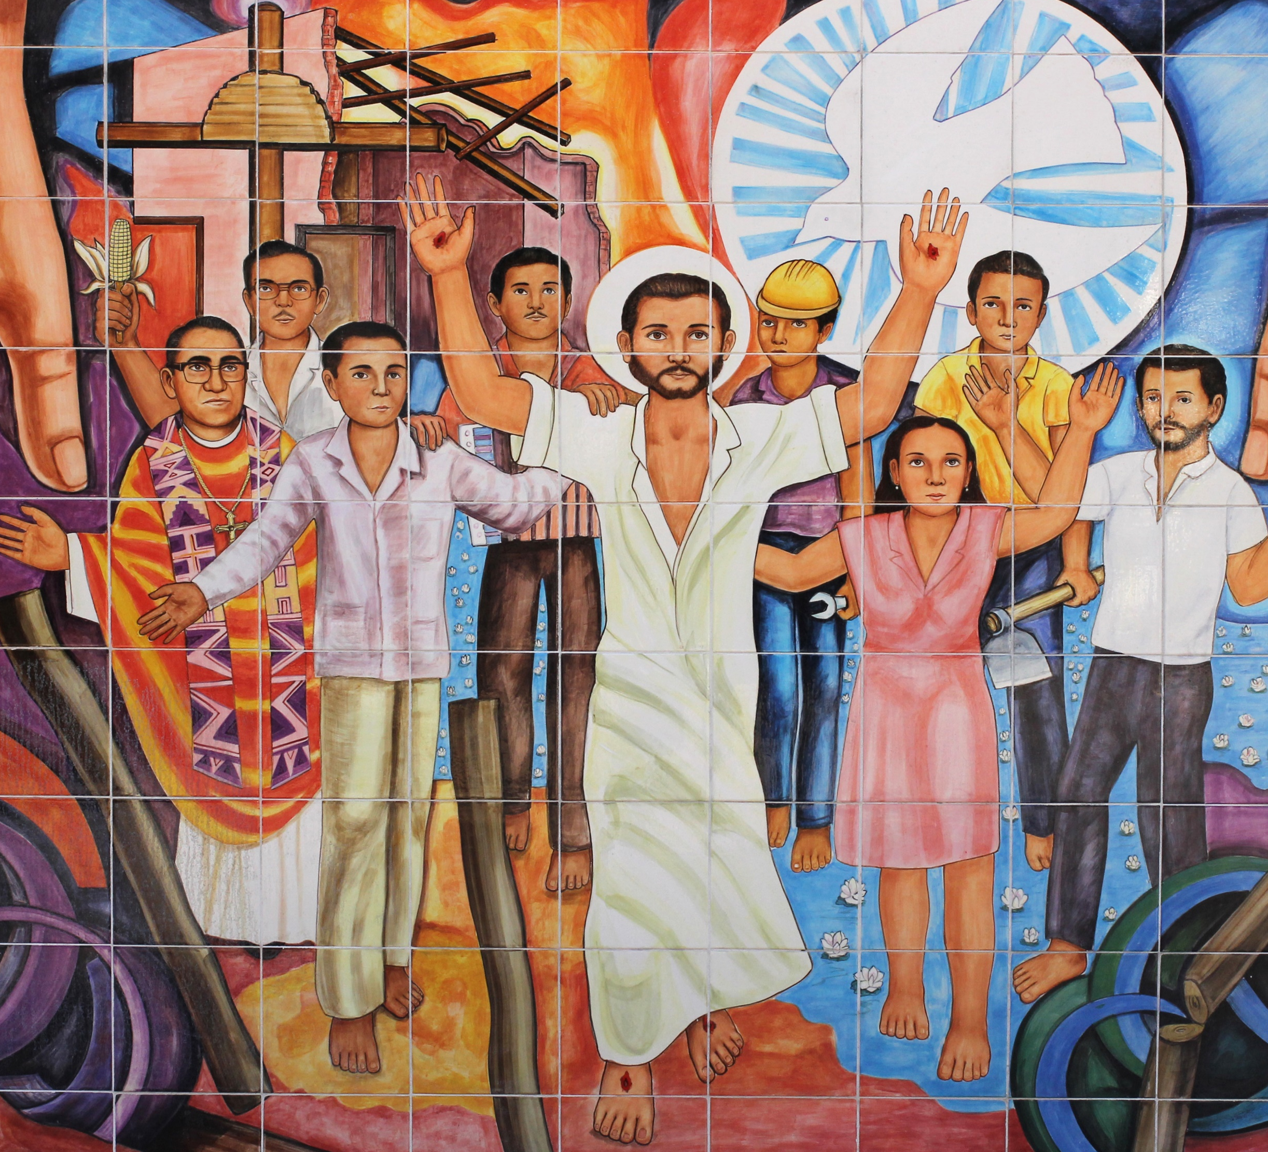
· Title: “Martires”
· Artist: Salvador Hernández
· Origin: America
· Date: 2003

Slide 43
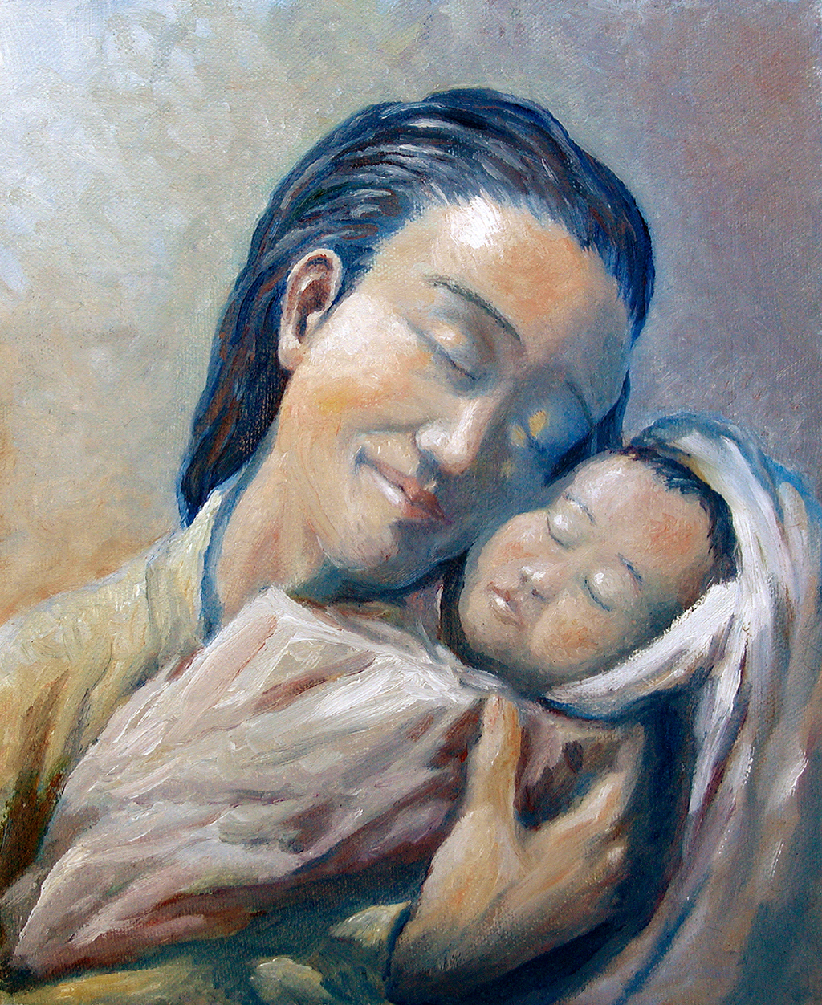
· Title: “Madonna and Child”
· Artist: David Zelenka
· Origin: America
· Date: 2005

Slide 44
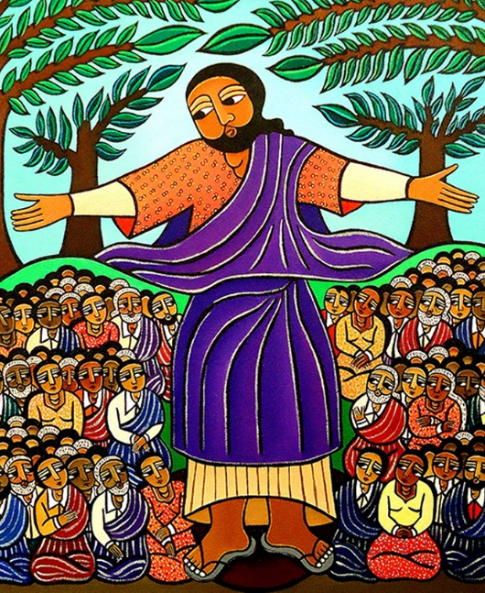
· Title: “Sermon on the Mount”
· Artist: Laura James
· Origin: America
· Date: 2010

Slide 45
· Title: “Blood, Body, Soul, and Divinity”
· Artist: Gladys Torres de Pirela
· Origin: Venezuela
· Date: 2012

Slide 46
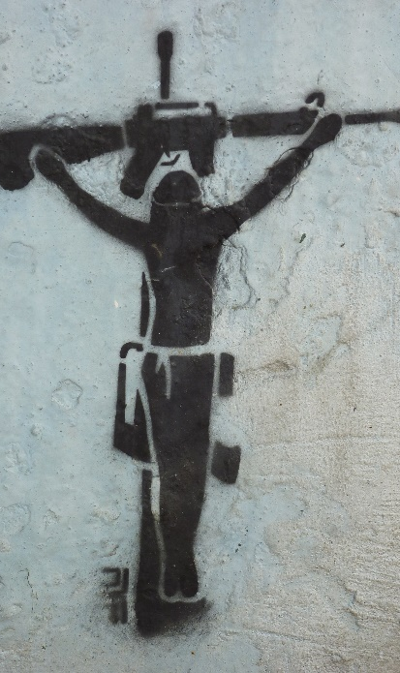
· Title: “Bogotá Graffitti 2”
· Artist: Photo by Avi Dolgin
· Origin: Colombia
· Date: 2012

Slide 47
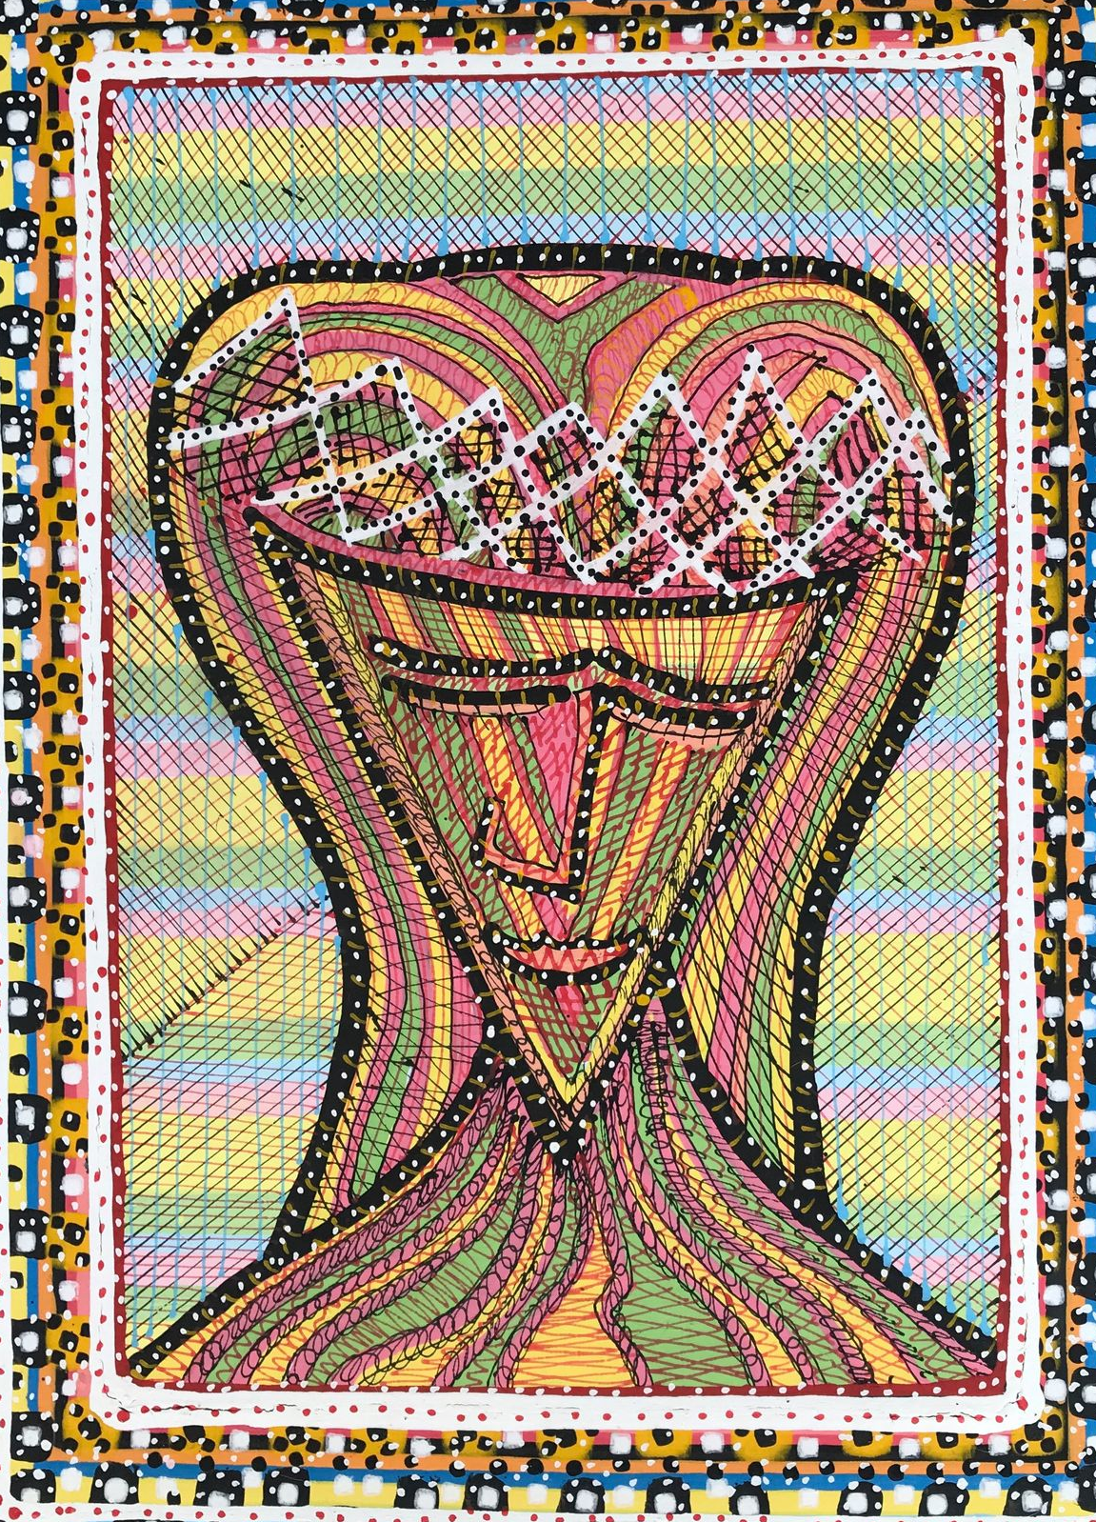
· Title: “The Divine Face”
· Artist: Luis Alberto Lizarazo
· Origin: Colombia
· Date: 2017

Slide 48
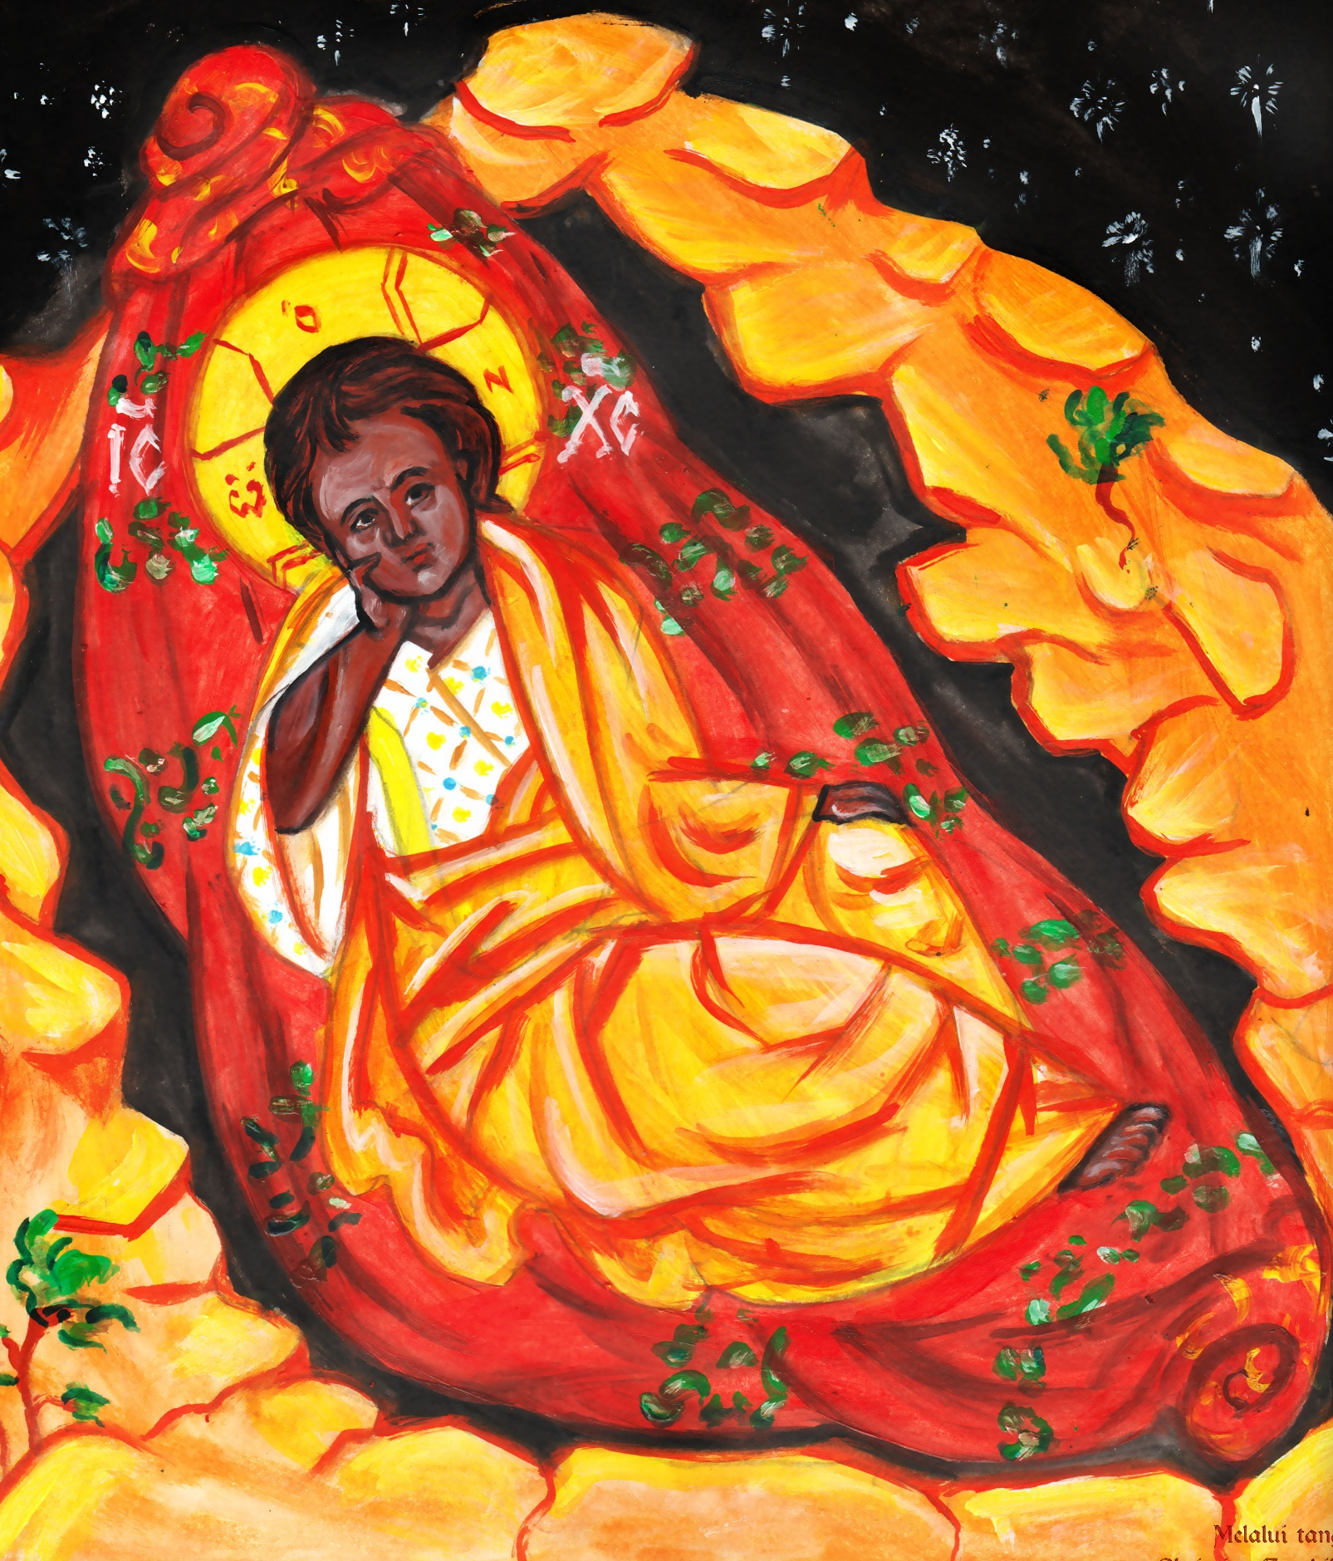
· Title: “Christ Anapenos (Eyes Never-Closed) Icon”
· Artist: Christian Tombiling
· Origin: Indonesia
· Date: 2019

Slide 49
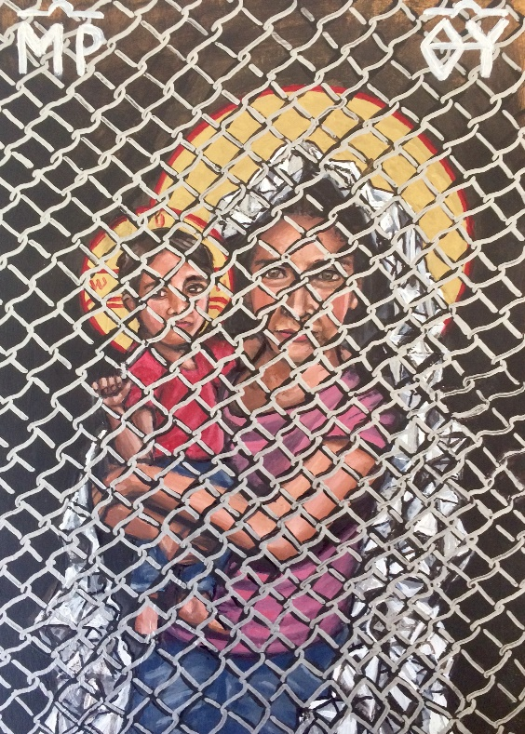
· Title: “Mother of God: Protectress of the Oppressed”
· Artist: Kelly Latimore
· Origin: America
· Date:2019

Slide 50
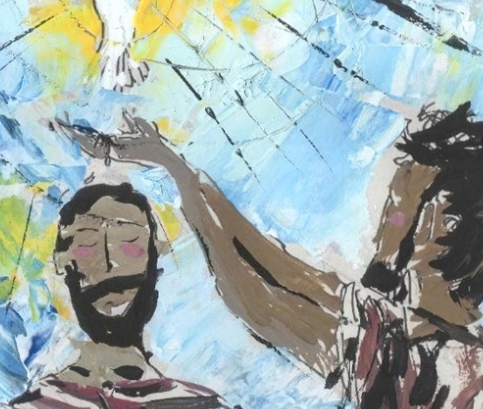
· Title: “Baptism of Jesus”
· Artist: Liz Valente
· Origin: Brazil
· Date: 2021

